Slide 1

Tamil Nadu- Internet and mobile users data
Presented by:
Simranjeet Kaur

Slide 2
A quick brief about the concepts/tools I used for this analysis:
Started the analysis by finding the appropriate data.
Data source: https://trai.gov.in/sites/default/files/PIR_08012020_0.pdf
Extracted data from pdf tables using python tabula library, performed data cleaning, converted into dataframe and saved it in excel format.
Performed analysis in form of visualizations in excel.

Slide 3

MOBILE USERS DATA

Slide 4
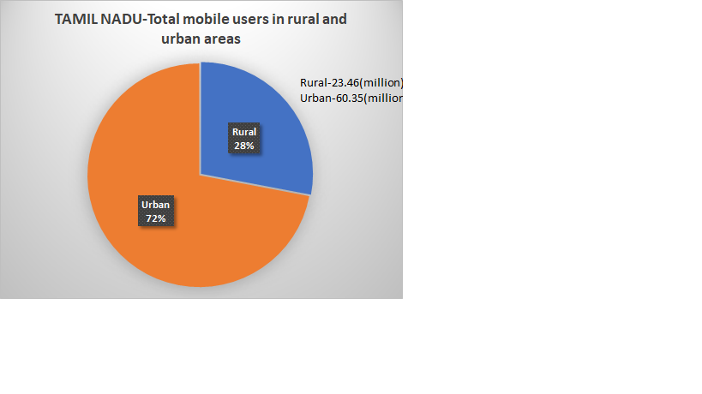
Total mobile users:
(Comparison between Rural and urban areas)
Total mobile users: 83.81 million.
Urban people uses more mobile as compared to rural people.

Slide 5
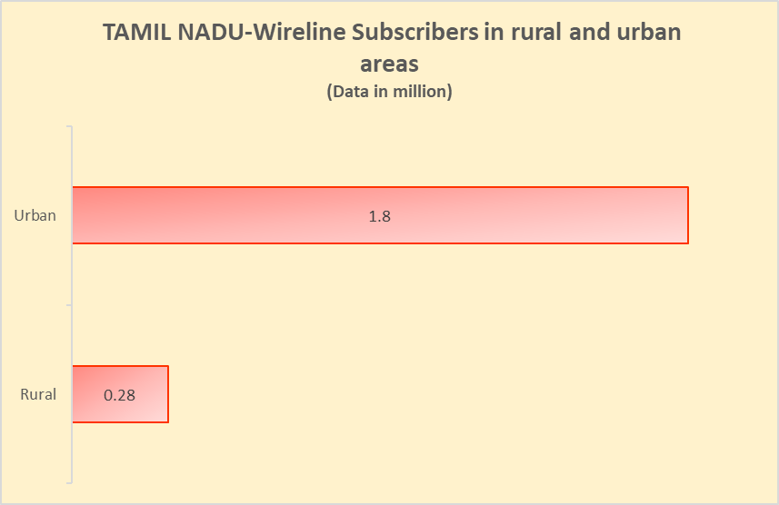
Mobile users are further classified as Wireless subscribers and wireline subscribers.
Wireless mobile users are more as compared to wireline.

Slide 6
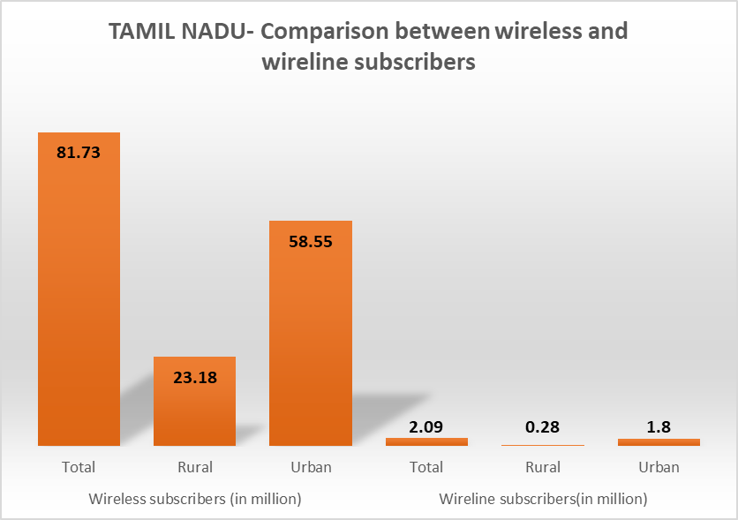
Single pictorial representation that compares both wireline and wireless mobile users.

Slide 7

INTERNET USERS DATA

Slide 8
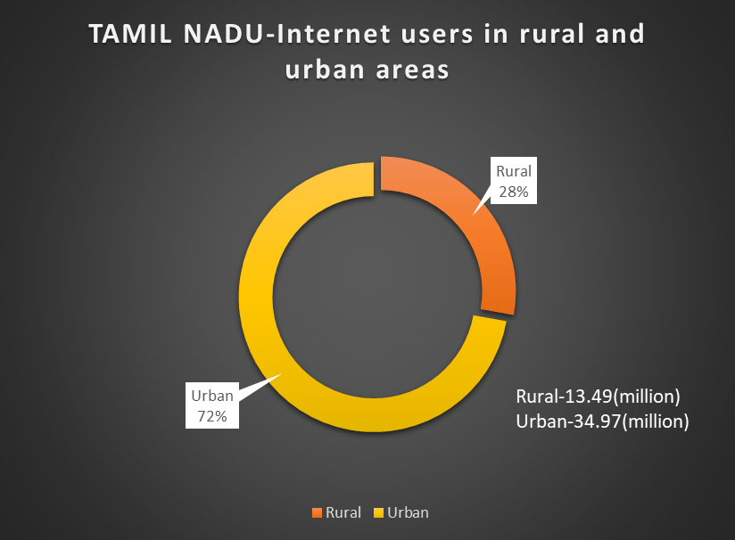
Total internet users in Tamil Nadu: 48.46 million.
Maximum internet users people are from urban areas.

Slide 9
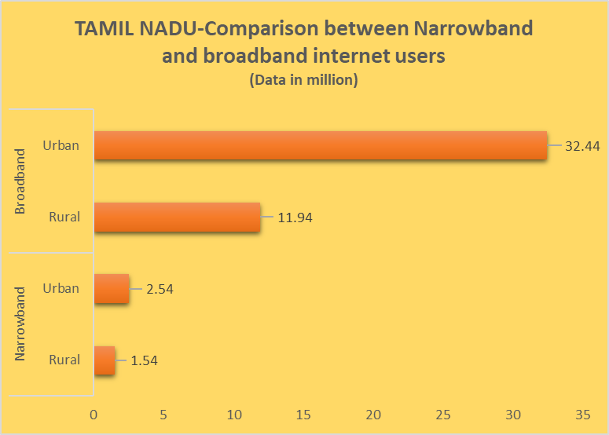
Key highlights: - Internet users are further classified as narrowband and broadband users. - Broadband internet users are more in both urban and rural areas.

Slide 10
Thanks for considering!
Small note: I tried my best to get the relevant data, but still was not able to find the data on the basis of gender and age parameters.

